Slide 1
Introduction to React JS
With ES6

Slide 2
Introduction
By the end of this course you will be familiar with React with ES6, Dev Environment set-up, React with Flux and Redux, testing and deployment
Pre-requisites – Basic JavaScript programming
About Me
10+ Experience in corporate training
5.5 years development experience with the leading US based financial client
Delivered training sessions across different location in India, Philippines, Spain and New York

Slide 3
Agenda
Morning
Noon
Introduction
Environment Setup
ES5
ECMA 2016/ES6
Render UI with React
JSX
React components
Props & States
React Events
Component Advanced
Ajax with fetch

Slide 4

Overview
By the end of Day 01 you should be able to
Set-up a dev environment
Create react app.
Create components
Understand states vs props
Develop a simple application by fetching data asynchronously.

Slide 5
Agenda
Morning
Noon
Introduction
Environment Setup
ES5
ECMA 2015/ES6
Render UI with React
JSX
React components
Props & States
React Events
Component Advanced
Ajax with fetch

Slide 6


ReactJS Introduction
React is an open source project created by Facebook
React is popular and used by the following

Slide 7

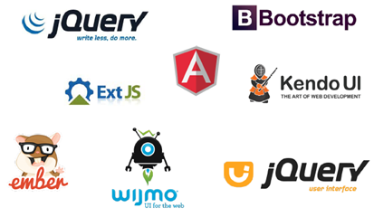
ReactJS Introduction
JSX
Fast
Virtual DOM
Isomorphic rendering
Composable
Isomorphic Friendly
Simple
Battle Proven
Risk of two-way Databinding
Unpredictable
Cascading Updates
Tricky Debugging

Slide 8
ReactJS Introduction
Reactive rendering is simple.
Uses Virtual DOM when data changes instead of rendering the whole page.
Component Oriented Development using Pure JavaScript
self-contained, concern-specific building blocks.
Use divide and conquer approach where no component is complex
React assumes the display logic and markup are highly cohesive
Flexible abstraction of the data model
React has its own lightweight representation of the UI that abstracts away the underlying document model.
This enables to render the HTML for the Web as well as native iOS and android views.

Slide 9



Single Page Application
Web app that loads a single HTML page is an SPA
App like user experience
Faster UI, more interactive
Able to work offline
Support multiple platforms (Responsive)
SPA uses Ajax and HTML5 to create fluid and responsive web apps without constant page reloads

Slide 10

Single Page Application
Traditional Page Lifecycle
SPA Page Lifecycle
Client
Initial Request
Server
Client
Initial Request
Server
HTML
HTML
Form Post
AJAX
Page reload
HTML
{..}
JSON
State change results in loading new page
Page do not reload due to navigation

Slide 11

Introduction to Node.js
Node.js was originally written in 2009 by Ryan Dahl
Node.js is a JavaScript runtime built on Chrome's V8 JavaScript engine.
Node.js uses an event-driven, non-blocking I/O model that makes it lightweight and efficient.
Node.js‘ package ecosystem, npm, is the largest ecosystem of open source libraries in the world.
Used in developing Server Side Web Applications written in JavaScript

Slide 12
Agenda
Morning
Noon
Introduction
Environment Setup
ES5
ECMA 2016/ES6
Render UI with React
JSX
React components
Props & States
React Events
Component Advanced
Ajax with fetch

Slide 13

Environmental Set-up

Slide 14
Agenda
Morning
Noon
Introduction
Environment Setup
ES5
ECMA 2015/ES6
Webpack & Hello-World React
JSX
Props & States
React Events
Component Advanced
Ajax with fetch

Slide 15
ES5
June 1997, Java Script is officially standardized
IBM, Borland, MS, NetScape, Sun, Stanford and Others
EcmaScript is a standard for scripting languages, a language spec
JavaScript is a implementation of ECMAScript
ES3 in 1999, ES4 in 2006, ES5 in 2011
European Computer Manufacturer’s Association
Notes:
ECMA – European Computer Manufacturer’s Association. Questions to the participants about scope

Slide 16
Module Formats
Limitations of ES5
Scope
Module Formats
Syntax used to define a module
CommonJS(Node.js)
AMD (Browser)
UMD(Node.js and Browser)
System.register

Slide 17
Module Loaders
A module loader interprets and loads a module written in a certain module format.
A module loader runs at runtime:
Examples
RequireJs:
loader for modules in AMD format
SystemJs:
Loader for modules in AMD, CommonJS, UMD and System.register format
Notes:
you load the module loader in the browser
you tell the module loader which main app file to load
the module loader downloads and interprets the main app file
the module loader downloads files as needed

Slide 18
Module Bundler
Replaces Module loader
Module bundler runs at build time
Run the module bundler to generate a bundle file at build time (e.g. bundle.js)
Load the bundle in the browser
Examples
Browserify: Bundler for CommonJs modules
Webpack: Bundler for AMD, CommonJs and ES6 modules.

Slide 19
Agenda
Morning
Noon
Introduction
Environment Setup
ES5
ECMA 2015/ES6
Webpack & Hello-World React
JSX
Props & States
React Events
Component Advanced
Ajax with fetch

Slide 20

ECMA 2015/ES6
ES6 is a significant update to the language, and the first update to the language since ES5 was standardized in 2009. Implementation of these features in major JavaScript engines is underway now.
Need for a “transpiler” to convert ES6 to ES5 for browser support
ES6
ES5

Slide 21

Babel
npm install g babel-cli
babel script.js
babel script.js --out-file output.js
npm install babel-preset-es2015 --save
create .babelrc
{
presets": ["es2015"]
}
babel script.js --out-file output.js
https://babeljs.io/docs/usage/cli/#installation
Notes:
Add a happy icon. Add babel --watch script.js -g output.js to watch the changes. No need to call the scripts again and again
$ babel src --out-dir lib

Slide 22
ECMA 2015/ES6 (Features)
Template Literals
Block Scope, Let, Constant, Variables
ES6 Classes, Inheritance, Getter, Setter
ES6 modules, export, import, module level scope
Rest, Deconstruct operator, arrow functions
ES6 Map

Slide 23
Agenda
Morning
Noon
Introduction
Environment Setup
ES5
ECMA 2015/ES6
Webpack & Hello-World React
JSX
Props & States
React Events
Component Advanced
Ajax with fetch

Slide 24
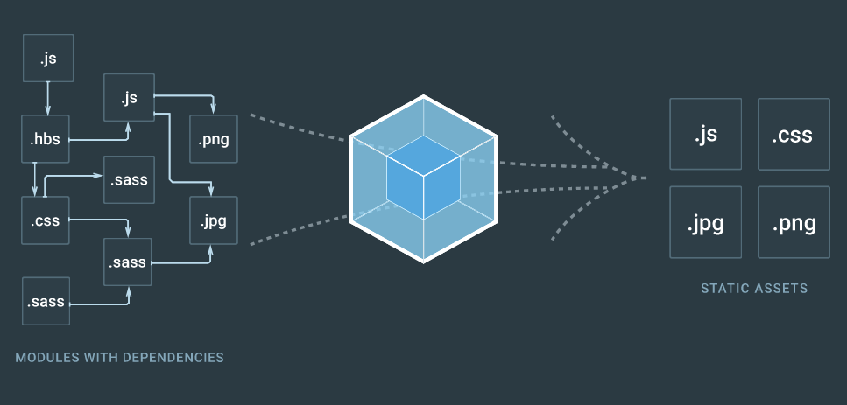
Introduction to WebPack
Bundles the modules with dependencies
https://webpack.js.org/

Slide 25
Set up Hello World react using WebPack
Create a folder
install webpack and webback-dev-server
Create an index.html and style using bootstrap
Install babel to convert the ES6 to ES5
Write a simple React

Slide 26
Agenda
Morning
Noon
Introduction
Environment Setup
ES5
ECMA 2015/ES6
Webpack & Hello-World React
JSX
Props & States
React Events
Component Advanced
Ajax with fetch

Slide 27
JSX
JSX is like a template language
Power like JavaScript
Written in JavaScript code
When transpiled , the XML is transformed into a function call to the React Library.
JSX is optional but preferred
Notes:
Notes
XML is great for representing UIs in element trees with attributes.
It's more concise and easier to visualize the structure of your application.
It's plain JavaScript. It doesn't alter the language semantics

Slide 28
JSX
Tag attributes are camelized
All elements must be balanced
The attribute names are based on the DOM api not based on HTML specs
HTML | JSX
<input type="text" maxlength="30" /> | <input type="text" maxLength="30" />
<br> <img src=“..”> | </br /> <img src=“.. />
<div id="box" class="some-class"></div> | <div id="box" className="some-class"></div>

Slide 29
JSX
Single Root Node
React components can render only a single root node
Conditional Clauses
If statements doesn't fit well in JSX
Alternative is to use ternary expressions and assigning conditionally to a variable
null and undefined values are treated by React and outputs nothing when escaped in JSX.
Styles
Cannot specify CSS inline

Slide 30
Summary
ES6 Fundamentals
Single Page Application (SPA)
Webpack set-up for React.js
JSX

Slide 31
Break

Slide 32
Agenda
Morning
Noon
Introduction
Environment Setup
ES5
ECMA 2015/ES6
Webpack & Hello-World React
JSX
Props & States
React Events
Component Advanced
Ajax with fetch

Slide 33
props & states
Components let you split the UI into independent, reusable pieces, and think about each piece in isolation.
Conceptually, components are like JavaScript functions.
They accept arbitrary inputs (called "props") and return React elements describing what should appear on the screen.
Props are Read-Only
Whether you declare a component as a function or a class, it must never modify its own props.
All react components must act as like pure functions with respect to their props.

Slide 34
props & states
Behavior and interactions are added to a component via this.state
this.state should be changed using this.setState
When the state is updated, the component triggers the reactive rendering, and the component itself and its children will be re-rendered.
Do not modify the states directly
Notes:
As mentioned, this happens very quickly due to React's use of a virtual DOM.

Slide 35
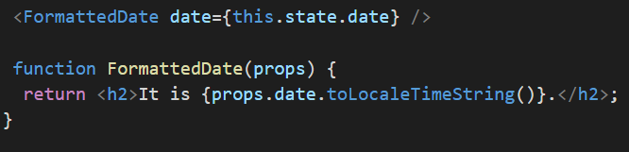
props & states
Neither Parent or a child component knows if a component is stateless or stateful.
Any state is not accessible other than the component that owns and sets it.
A component may choose to pass its state down as props to its child components
This is "top-down" or "unidirectional" data flow.

Slide 36
props & states
Props
Components Configuration
State
Starts with the default value defined in the constructor
Immutable
Received from above
Suffers mutations based on event
Every time the state changes component is rendered again

Slide 37
props & states
Props
State
React Architecture
events
Render
DOM
Model + Component = DOM

Slide 38
Agenda
Morning
Noon
Introduction
Environment Setup
ES5
ECMA 2015/ES6
Webpack & Hello-World React
JSX
Props & States
React Events
Component Advanced
Ajax with fetch

Slide 39
React Events
React implements a Synthetic event system
consistency and high performance to React applications and interfaces.
Normalized the events and have same properties across different browsers and platforms
HTML Events Problems
With global scope it has undesirable side effects
It's hard to track in the context of a big HTML file
it can be slow
it can lead to memory leaks
JSX removes the side-effects. Scoped within the component

Slide 40


React Events
Events are Camel Case
Pass function as event handler and not the string
HTML
JSX

Slide 41
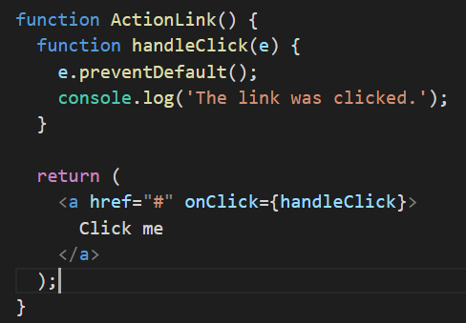
React Events
To prevent event default behavior call preventDefault().
HTML
JSX

Slide 42
Agenda
Morning
Noon
Introduction
Environment Setup
ES5
ECMA 2015/ES6
Webpack & Hello-World React
JSX
Props & States
React Events
Component Advanced
Ajax with fetch

Slide 43
Component Advanced
Prop Validation
Can be done using PropTypes
Act like documentation
Default values is provided using defaultProps
https://facebook.github.io/react/docs/typechecking-with-proptypes.html

Slide 44
Component Advanced
Lifecycle methods
Use lifecycle methods to listen the changes in the component
componentWillReceiveProps
invoked when a component is receiving new props. Calling this.setState() within this function will not trigger an additional render
componentWillUpdate()
Executed before the render() method of your component is called again (as a result to changes to the properties or state).

Slide 45
Component Advanced
componentDidUpdate()
Executed after the render() method is done and the new changes to the underlying DOM have been applied.
componentWillMount()
Executed before the node is inserted into the DOM.
componentDidMount()
Executed after the node is inserted into the DOM.
componentWillUnmount()
Executed right before the component is removed from the DOM.

Slide 46

Component Advanced
shouldComponentUpdate(newProps, newState)
This method is called before componentWillUpdate() and gives you a chance to return false; and cancel the update, which means your render() method won’t be invoked.
Useful in performance-critical areas of the app when you think nothing interesting changed and no rerendering is necessary.
Make this decision based on comparing the newState argument with the existing this.state and comparing newProps with this.props

Slide 47
Component Advanced
Stateful components
Components that manage state.
Respond to user input or server response etc
Stateful components usually are higher on the component hierarchy and wrap one or more stateless or pure components.
Stateless or Pure Components
Accept only props.
Easy to reuse and test those components.

Slide 48

Component Advanced
Most components should be stateless
Which component should be stateful
Identify every component that renders something based on that state.
Find a common owner component
Either the common owner or another component higher up in the hierarchy should own the state.
If owner cannot be found create an owner that holds the state

Slide 49
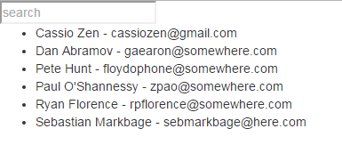
Simple Contact Search Application
On searching the text , list should show only the searched contacts
Search Input should display the contact
App
ContactSearch
Contact List

Slide 50
Agenda
Morning
Noon
Introduction
Environment Setup
ES5
ECMA 2015/ES6
Webpack & Hello-World React
JSX
Props & States
React Events
Component Advanced
Ajax with fetch

Slide 51
Simple Contact Search Application
Modify the sample to fetch data using fetch
App
ContactSearch
Contact List

Slide 52
Summary
Props and States
React Events
LifeCycle Methods
How to architect components
Fetch data asynchronously

Slide 53
More Information
https://egghead.io/technologies/react
https://engineering.musefind.com/react-lifecycle-methods-how-and-when-to-use-them-2111a1b692b1
React Up and Running - by Stoyan Stefnav
Oreily Publications

